Slide 1

Open Positions for Waste Research Team
Waste Drone
Impact Analyst
Process Analyst
Associate

Slide 3
The End Of The World
Notes:
Our business model

Slide 4
Upcycling the Apocalypse
Notes:
It

Slide 5
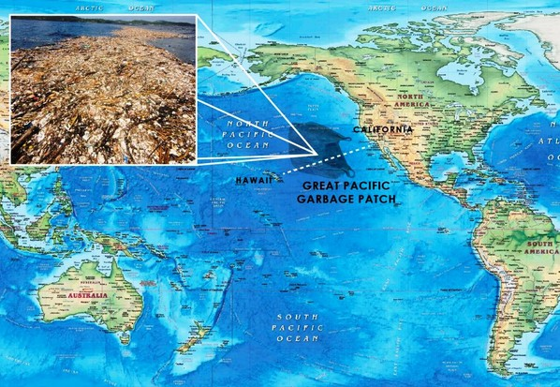
Great Pacific Garbage Patch
Exciting Opportunity?
Ecological Disaster?

Slide 6
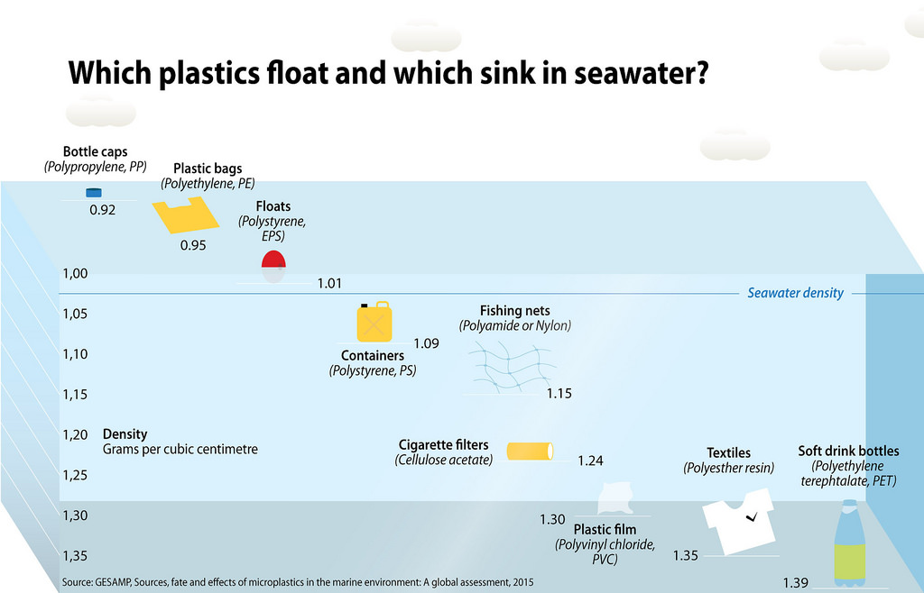
Our Research

Slide 7
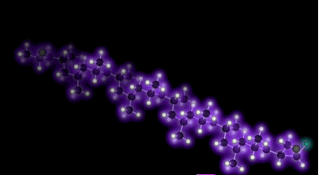
Polypropylene

Slide 8
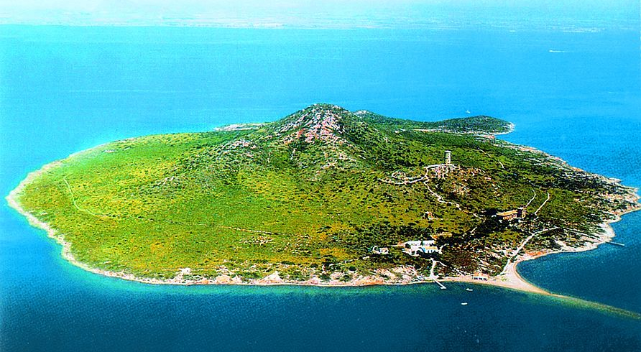
Artificial Garbage Island

Slide 9
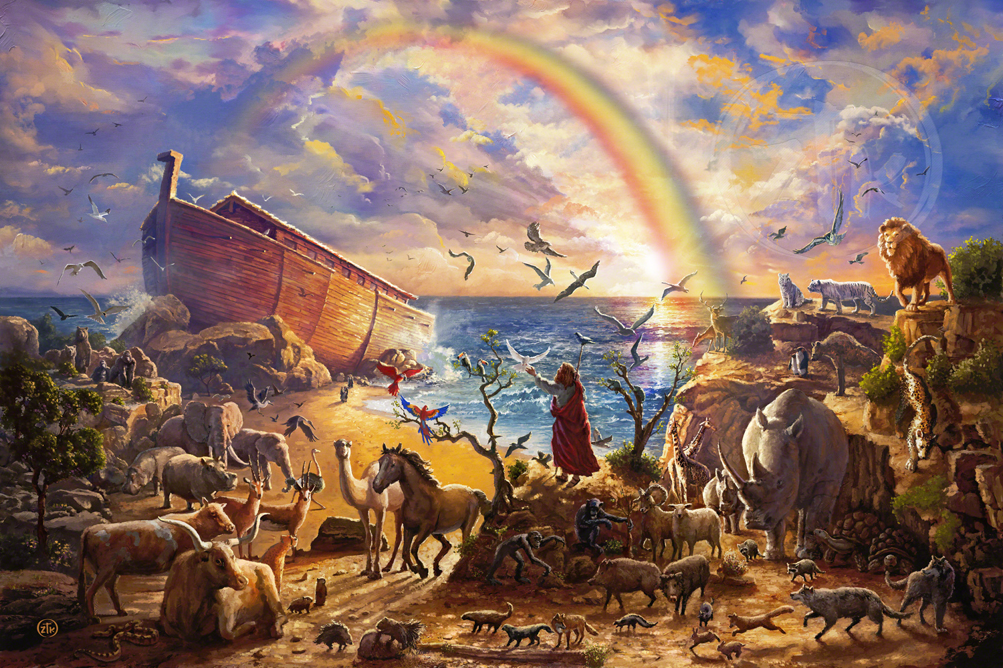
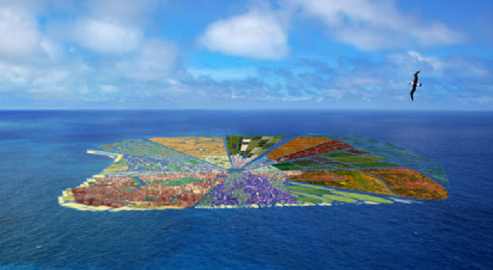
Noah’s
Theong’s
Ark

Slide 10

And That’s Where You Come In

Slide 11
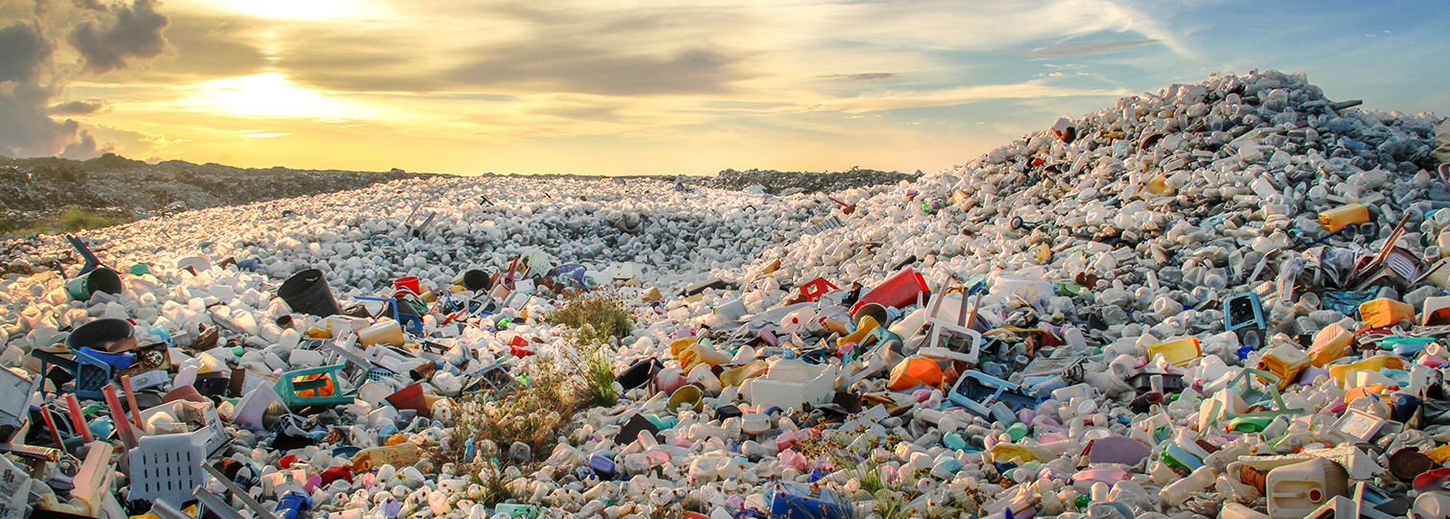
Waste R&D

Slide 12
Today’s Agenda
Intros and Icebreakers
Team Assignments
Data Collection aka “The Hunt”
Moral Boosting
Results Reporting

